Slide 1
Web Centralized Platform for
Dean Apparels [PVT] LTD

Slide 2
Content
1. Background
2. Problems
3. Motivation
4. Aim
5. Objectives
6. Methodology
7. Literature review
8. System Functions

Slide 3
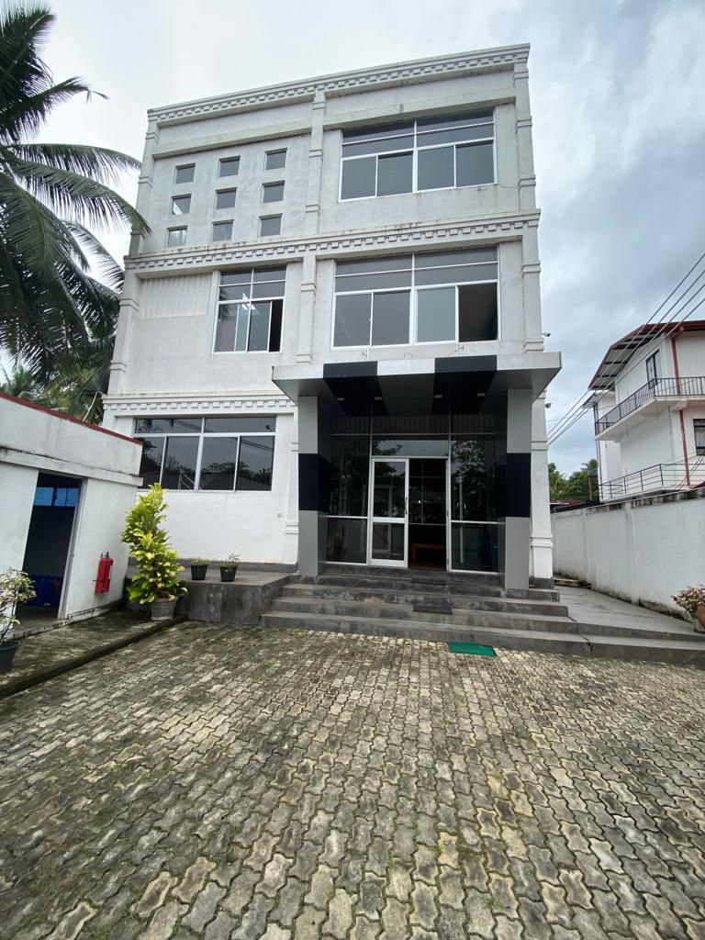
Background
Dean Apparels creates and sells men's clothing.
A system is being implemented to improve business operations due to manual management.
System will increase productivity, decrease errors, and improve marketability.

Slide 4




Difficult to access the employee information When Needed
Orders are placed via email ,Phone or by In Contact
Problems
Employees unable to see their own profile status
Manual handling

Slide 5
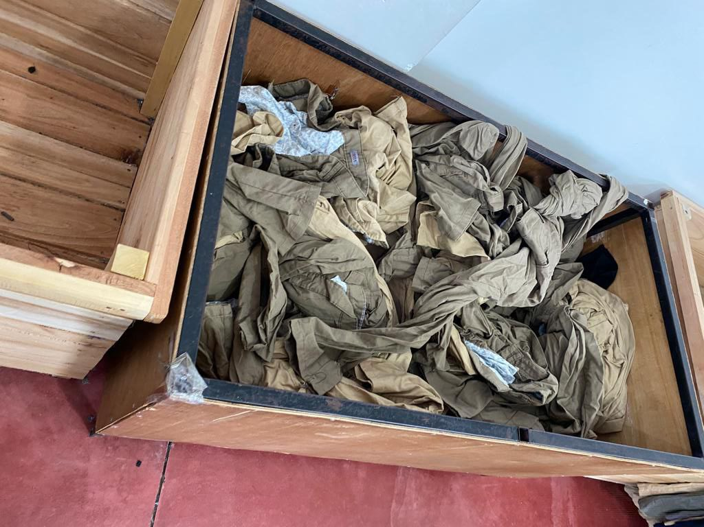
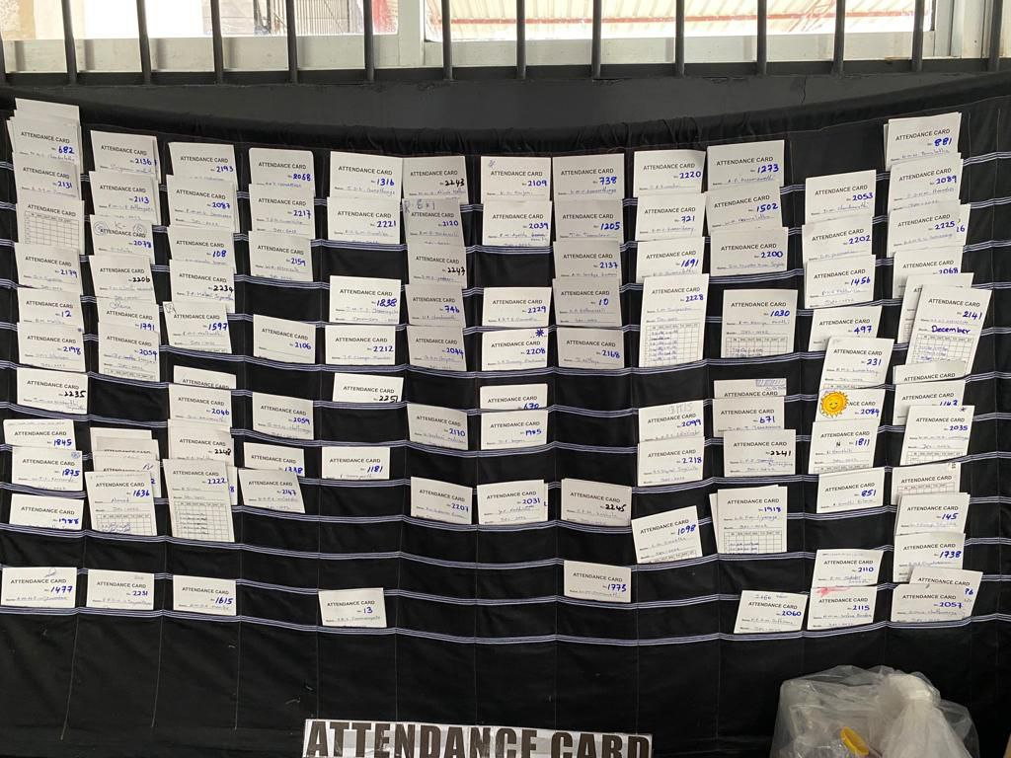
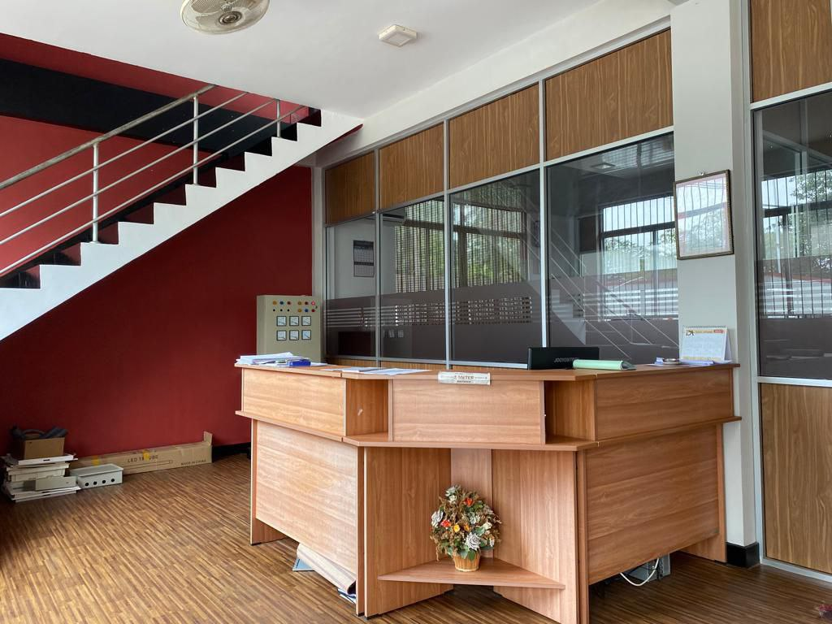
Some Pictures

Slide 6
Motivation
Simplifies calculations and reporting.
Enhances communication between customers and employees.
Maintains accurate data management.
Streamlines payment processing.
Automates order management for better customer satisfaction

Slide 7

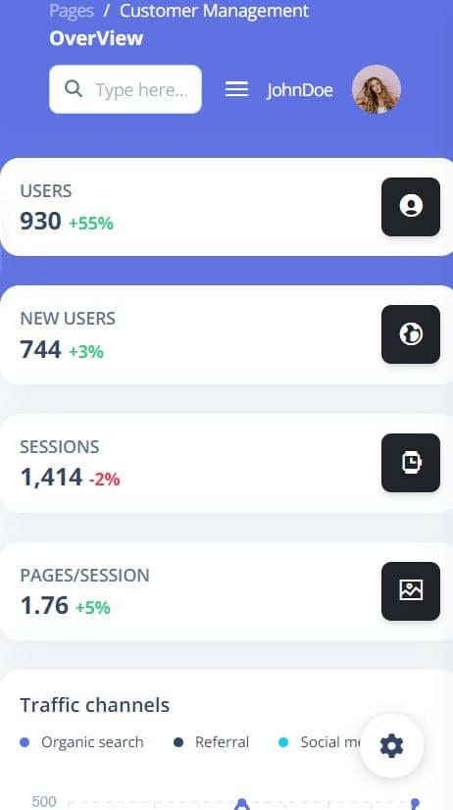
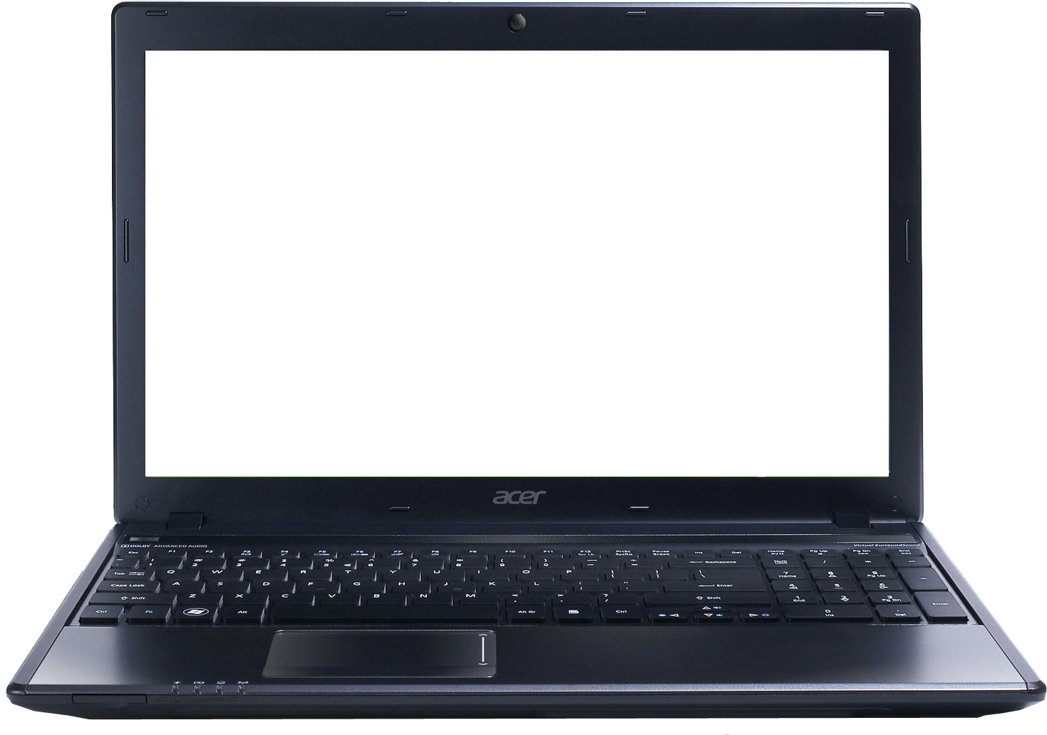
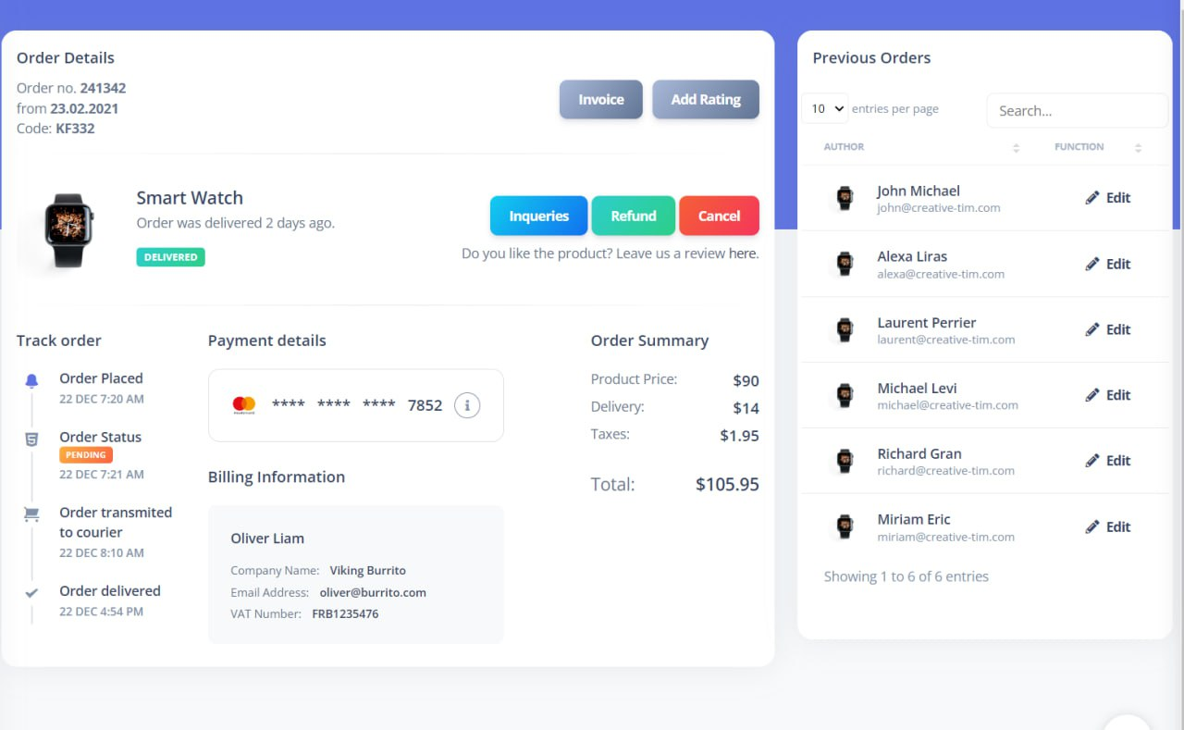
Aim
“To develop across platform ERP system for Dean Apparels, covering all business activities, improving, efficiency and productivity.”

Slide 8
Identify the user requirements
Identify potential drawbacks of the existing system
Create wireframe and make any necessary modification
Enhancing UI/UX.
Create ER diagrams and relational schema
Create the system database.
Implement Functionalities
Deliver the Initialized functioning product to the client
provide support to customer, until he adapt to system successfully
use client feedback to develop better system
Objectives

Slide 9
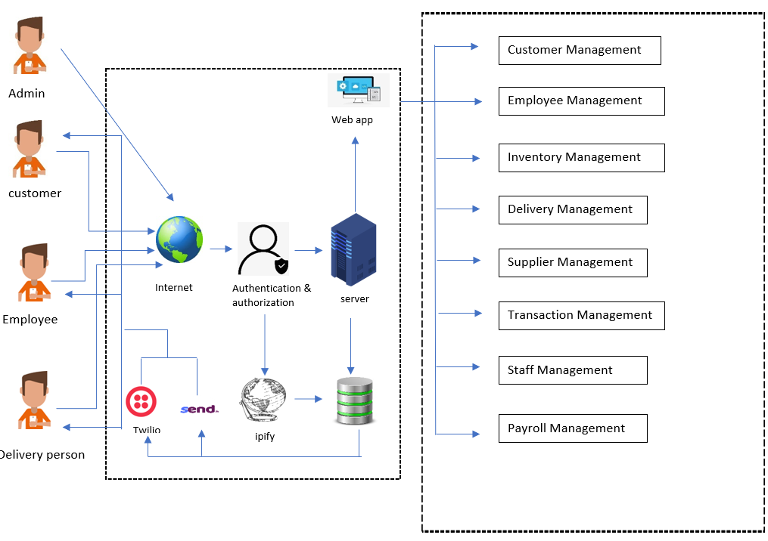
System Overview

Slide 10

Literature Review
SAP S/4HANA
Advantages
Integration
Real-time insight
Streamlined processes
Disadvantages
High training costs
High resource usage
Restricted adaptability
High implementation costs and Time Consuming Procedure

Slide 11

Literature Review
Oracle ERP Cloud
Advantages
Improved collaboration
Advanced automation
Disadvantages
Limited customization options
Limited reporting capabilities
Complex user interface
High implementation costs

Slide 12





Methodology
Technologies
Java, MySQL, GIT, Bootstrap, API’s, JQUERY
Testing Methods
Unit testing, Integration testing, Acceptance testing, System testing
Design Methods
Use case Diagram, Object Orient design, UML
Tools

Slide 13
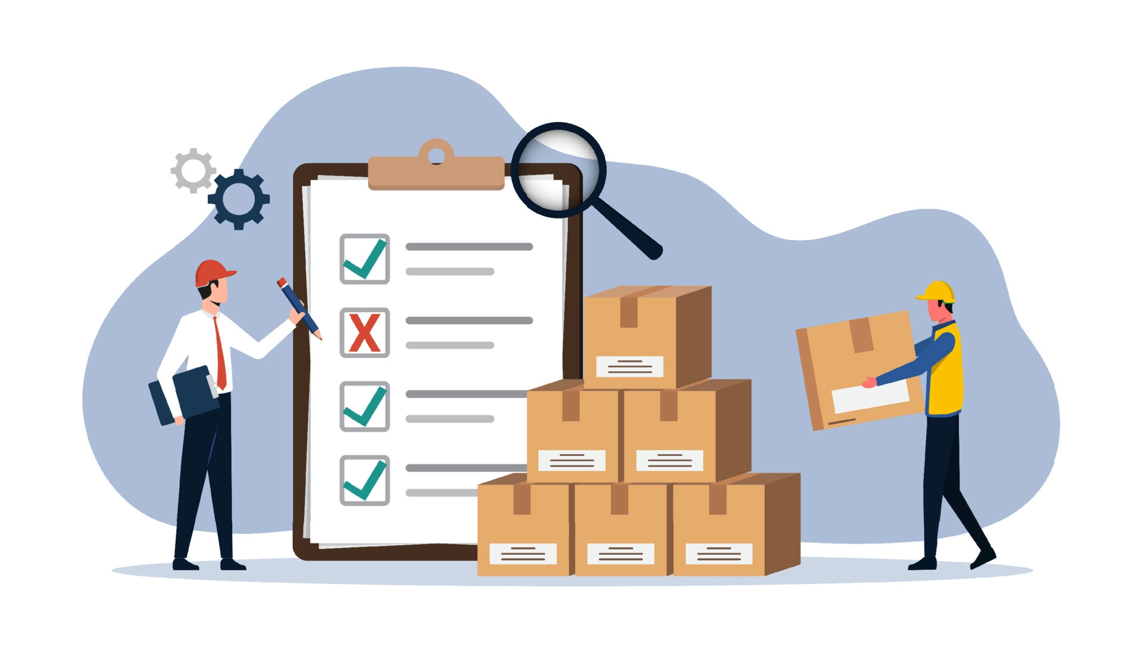







System Functions
Delivery Management
Employee Management
Inventory Management
Supplier Management
Financial Management
Order Management
Payroll Management
Customer Management

Slide 14

Customer Management
Functional Requirements
Customer profile handling
Take actions for customer inquires and Feedbacks
Manipulate a customer
Steady communication with the customer
Generate reports
Live analytics

Slide 15

Non-functional Requirements
Scalability
Portability
Usability
Security
Technical Requirements
Printer

Slide 16

Order Management
Functional Requirements
Order processing
Order Reporting
Monitering Orders

Slide 17
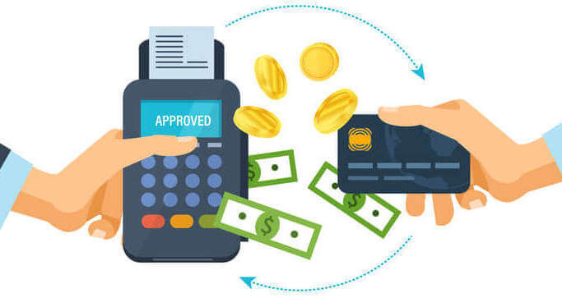
Nonfunctional Requirements
Maintainability
Security
Performance
Technical Requirements
Printer

Slide 18

Delivery Management
Delivery persons acccess the system
Location tracking
Update and information about the delivery
Display the delivery details
Generate report using delivery details

Slide 19

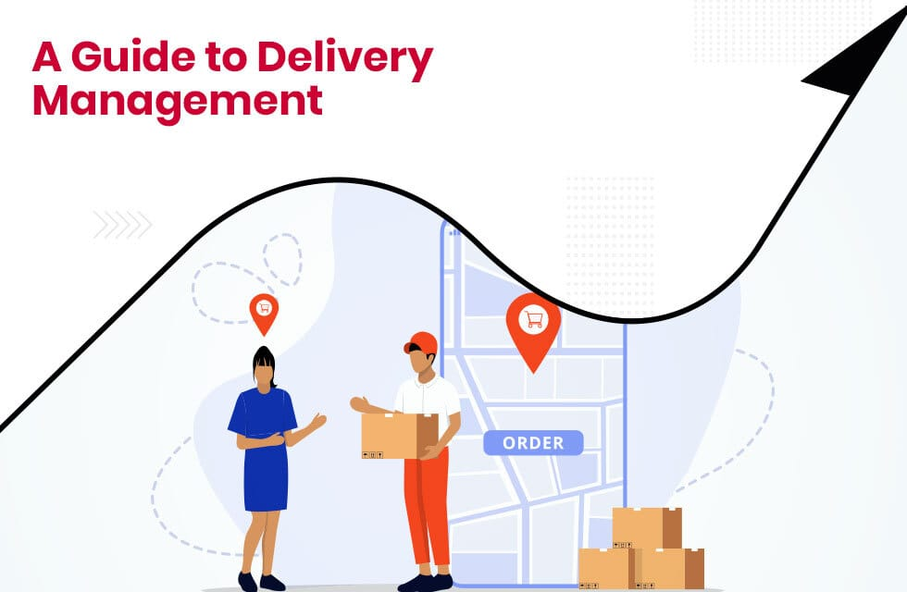
Nonfunctional Requirements
Reliability
Performance
Scalability
Technical Requirements
GPS Tracking
QR Code Scanner

Slide 20

Financial Management
Functional Requirements
Payment Handling
Generate Payment report
Approve Payments

Slide 21

Nonfunctional Requirements
Performance
Security
Technical Requirements
Printer
Fingerprint reader

Slide 22

Employee Management
Functional Requirements
Employee onboarding and offboarding processes
Employee information management
Time and attendance tracking
Reporting and analytics

Slide 23

Nonfunctional Requirements
Usability
Reliability
Security
Technical Requirements
NFC Cards and Readers
DBMS

Slide 24

Payroll Management
Functional Requirements
Payroll processing
Report generating
Security and Access control
Allowance, Deduction Management

Slide 25


Nonfunctional Requirements
Scalability
Usability
Reliability
Maintainability
Technical Requirements
Fingerprint scanner
Printer

Slide 26

Supplier Management
Functional Requirements
Manage Suppliers Accounts and details
Place Orders
Insert GRN to the System
Settle payments

Slide 27

Nonfunctional Requirements
Portability
Security
Technical Requirements
Printer
Barcode reader

Slide 28

Inventory Management
Functional Requirements
Inventory Tracking
Integration
Analytics and Reporting

Slide 29
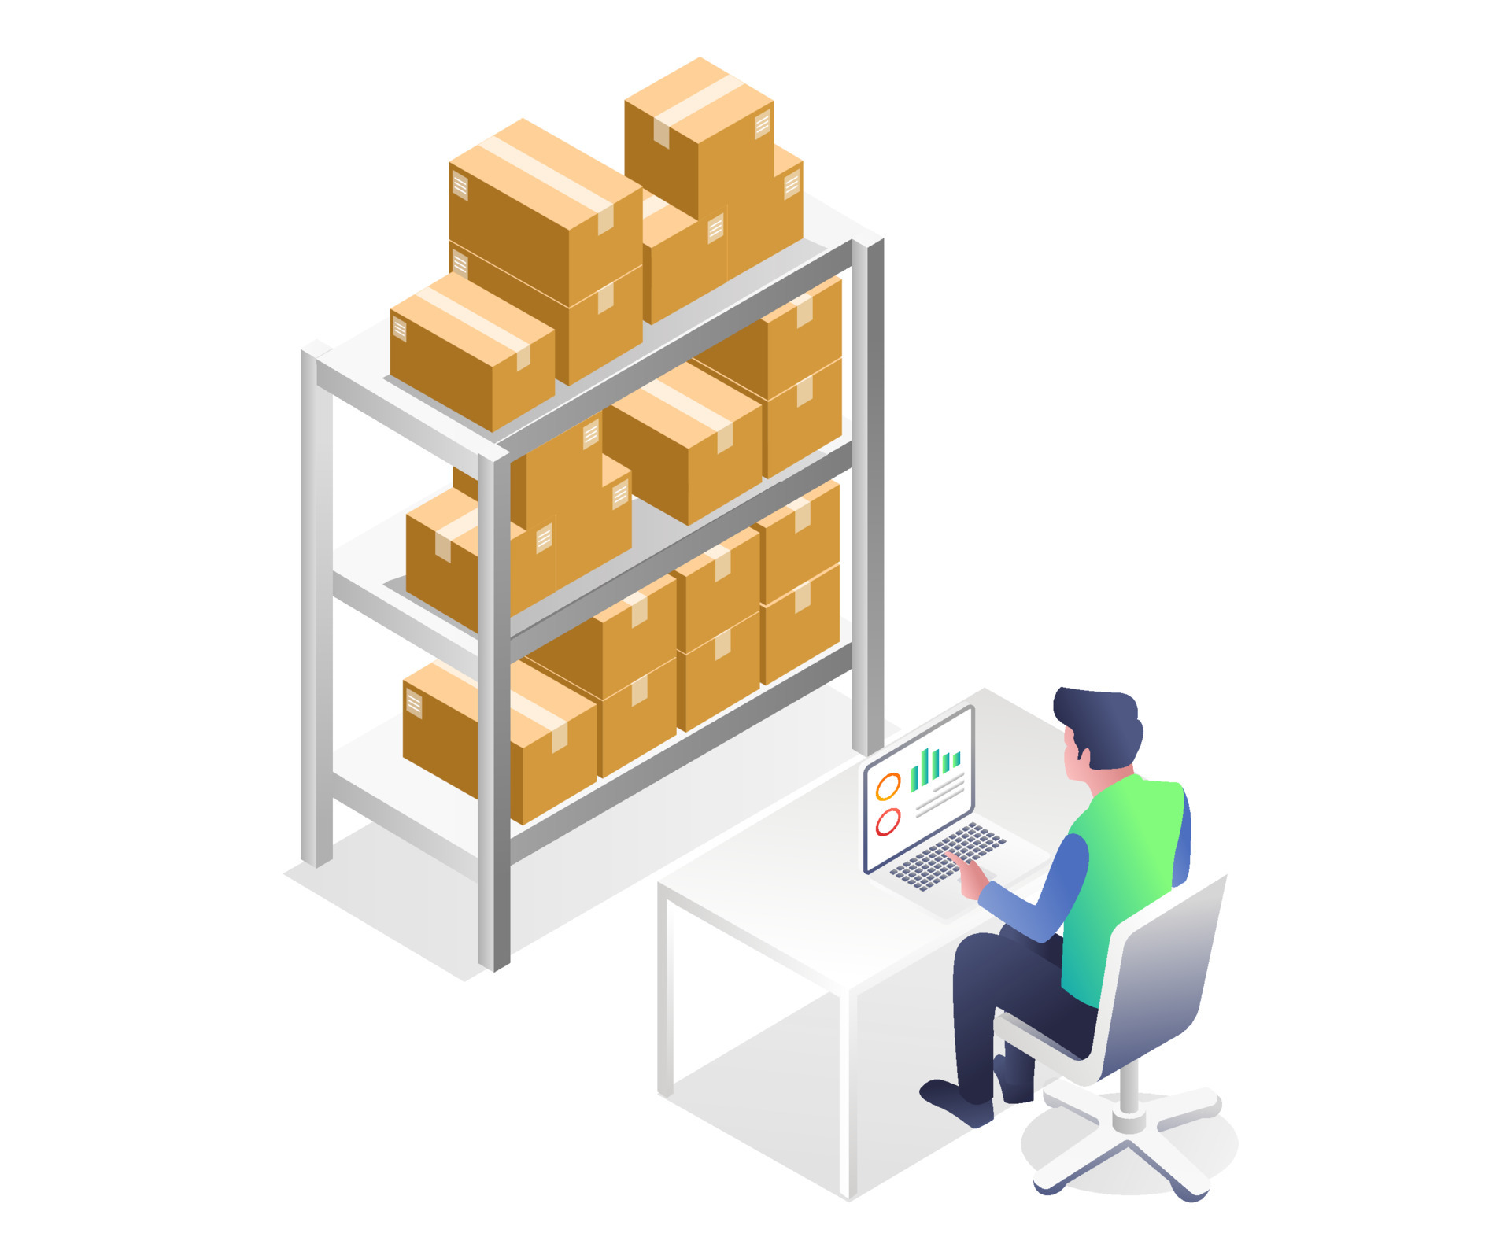
Nonfunctional Requirements
Real time performance
Accuracy
Technical Requirements
Barcode reader
Bill counter

Slide 30
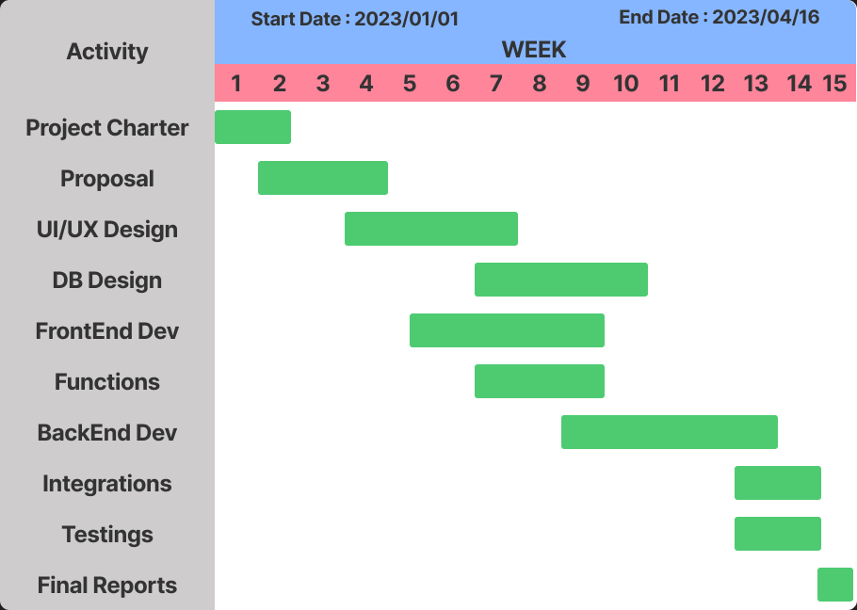
Gantt chart

Slide 31
Thank You !

